Slide 1
Data Structures and Algorithms -3 (25CS2103E)
News and Social Media Analytics Engine
Team Members
N Charishma: 2520090214.
Kaveri: 2520090068.
Under the Esteemed Guidance of
K Chandusha

Slide 2
Contents
Abstract
Introduction
Literature survey
Problem Statement and Objectives
Hardware and Software requirements
Results
Conclusion
Future Scope

Slide 3
Abstract
Analyzes news and social media content.
Classifies text into Positive, Negative, and Neutral sentiments.
Identifies frequently occurring keywords and trending topics.
Displays results through an interactive web dashboard.
Helps users understand opinions and popular topics quickly.

Slide 4
Introduction
News and social media generate large amounts of textual data.
Manually analyzing every record takes time.
Sentiment analysis helps identify opinions in text.
Trend detection finds frequently occurring keywords.
Our project automates these tasks using Java and web technologies.

Slide 5
Literature Survey
Existing news analytics systems collect and organize news articles.
Sentiment analysis systems classify text based on opinions.
Text-mining systems identify frequently occurring words.
Data visualization dashboards present analytical results.
Our project combines sentiment analysis, trend detection, and visualization in one application.

Slide 6
Problem Statement and Objectives
Problem Statement
Manually analyzing news and social media content is time-consuming.
It is difficult to identify overall sentiment and popular topics from large amounts of text.
Objectives
Load news and social media data from a CSV file.
Clean and preprocess textual data.
Classify content as Positive, Negative, or Neutral.
Identify frequently occurring keywords.
Display sentiment and trend information on a dashboard.

Slide 7
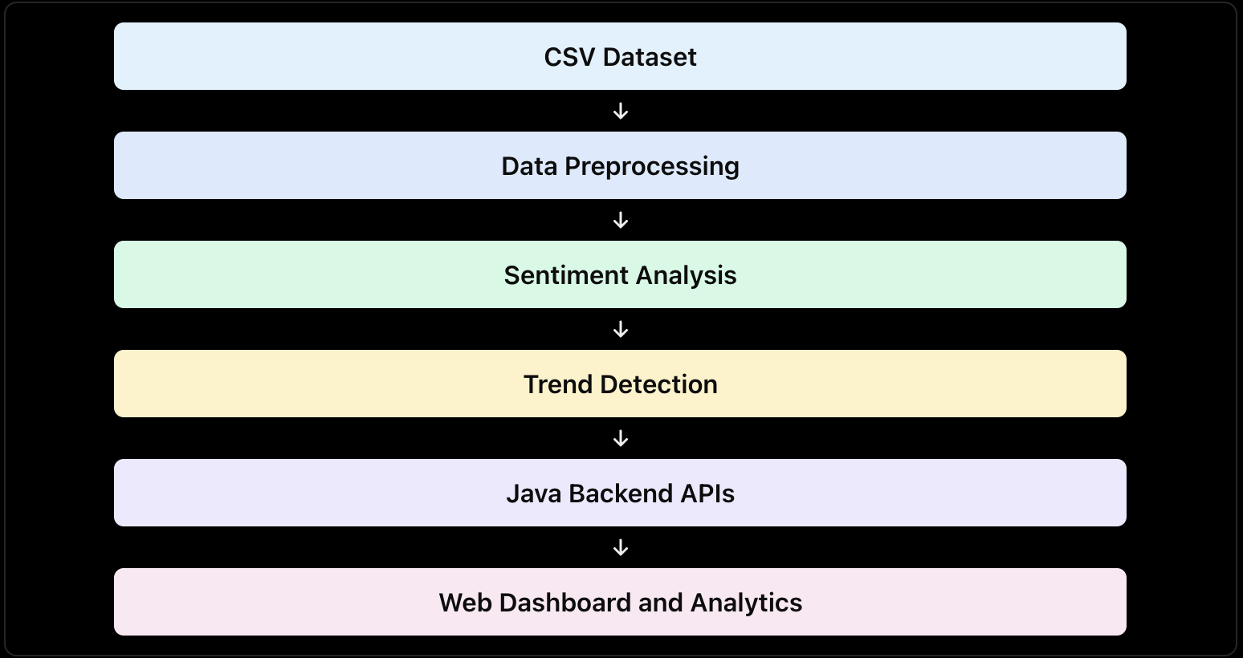
Flow Chart

Slide 8
Results
Displays the total number of dataset records.
Shows Positive, Negative, and Neutral sentiment counts.
Displays frequently occurring keywords and trending topics.
Provides a news feed with individual records.
Shows category-wise and source-wise analytics.
Presents the results through a user-friendly dashboard.

Slide 9
Hardware and Software requirements
Hardware
Laptop or desktop computer
Minimum 4 GB RAM recommended
Keyboard and mouse
Internet browser
Software
Java Development Kit (JDK)
Visual Studio Code
HTML
CSS
JavaScript
CSV dataset
Google Chrome or another web browser

Slide 10
Conclusion
Successfully developed a news and social media analytics web application.
Implemented text preprocessing using Java.
Analyzes sentiment using a rule-based approach.
Identifies frequently occurring keywords.
Presents analytical results through a web interface.

Slide 11
Future Scope
Integrate live news and social media APIs.
Use machine learning models for improved sentiment classification.
Add more languages.
Provide date-wise trend analysis.
Add interactive charts and downloadable reports.
Improve accuracy using larger and more diverse datasets.

Slide 12
Thank you

